Slide 1

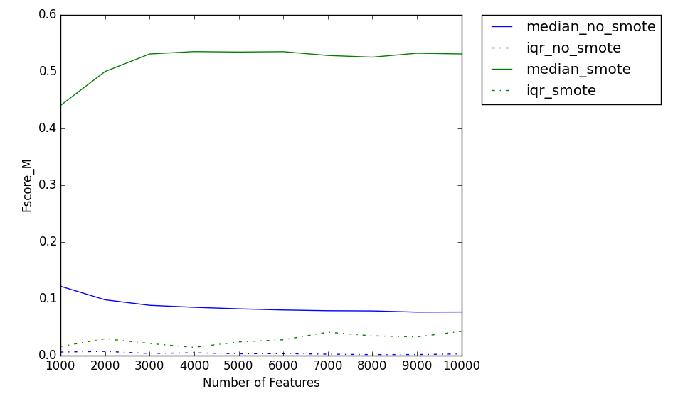
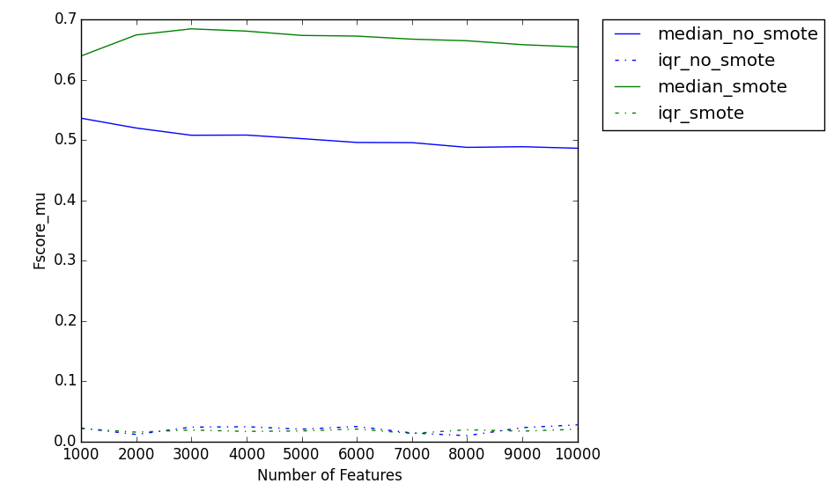
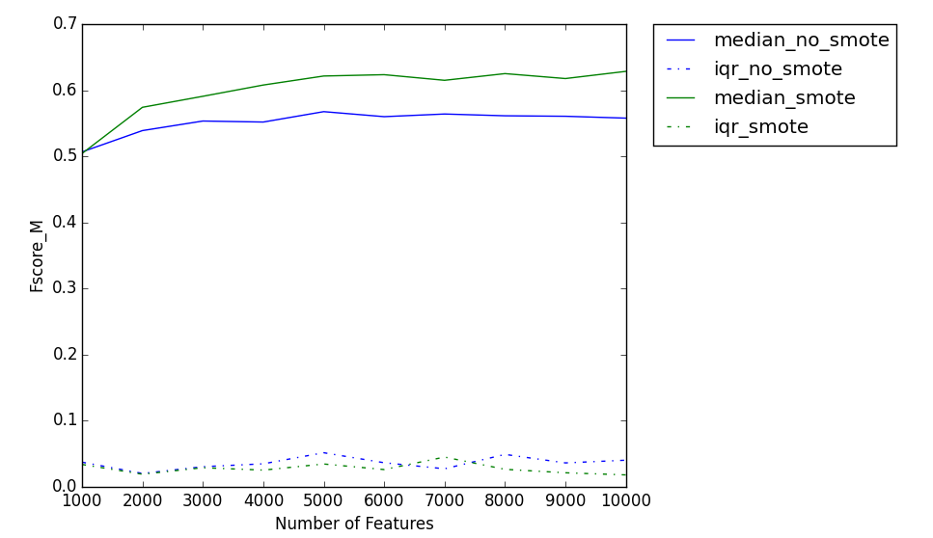
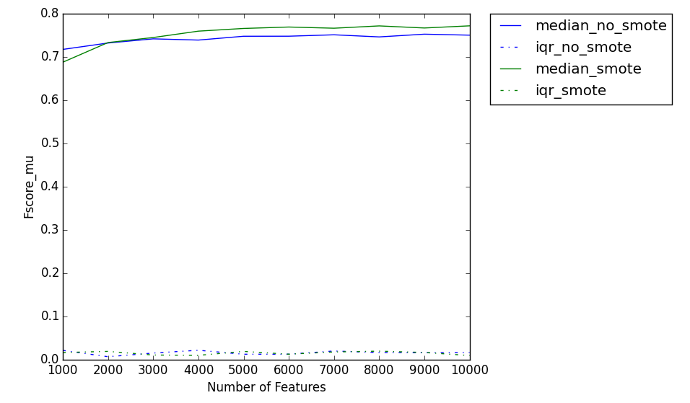
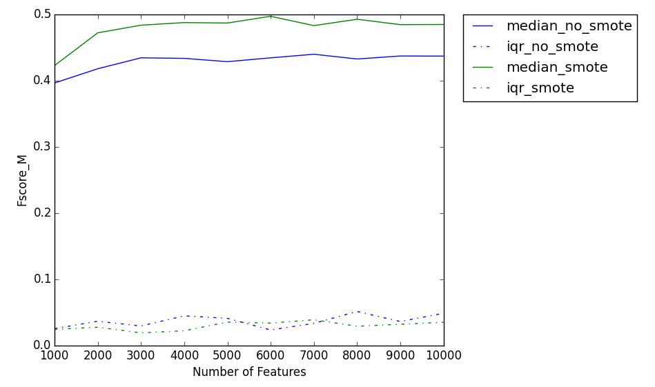
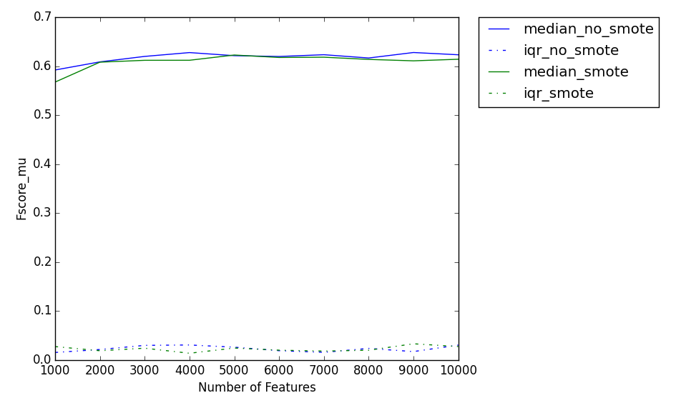
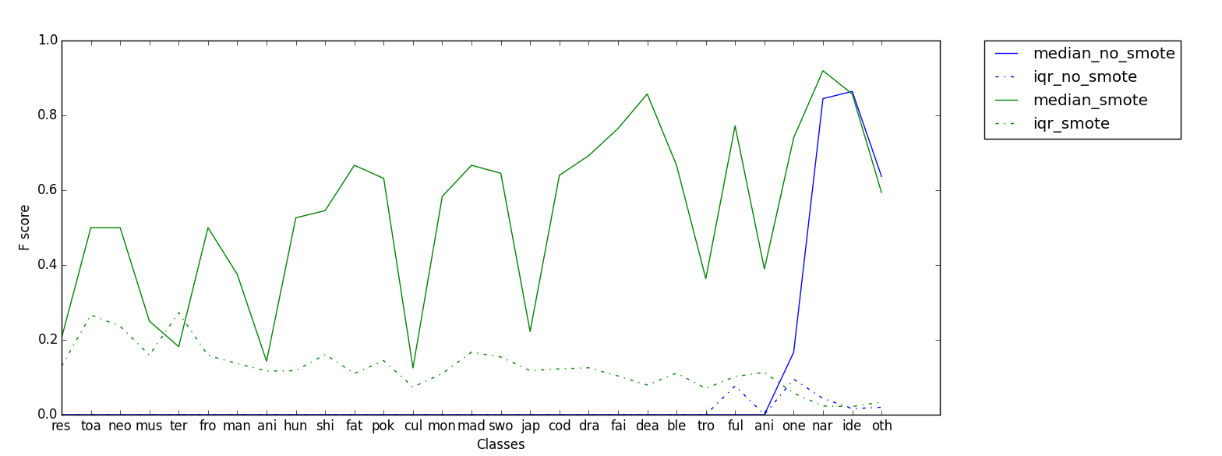
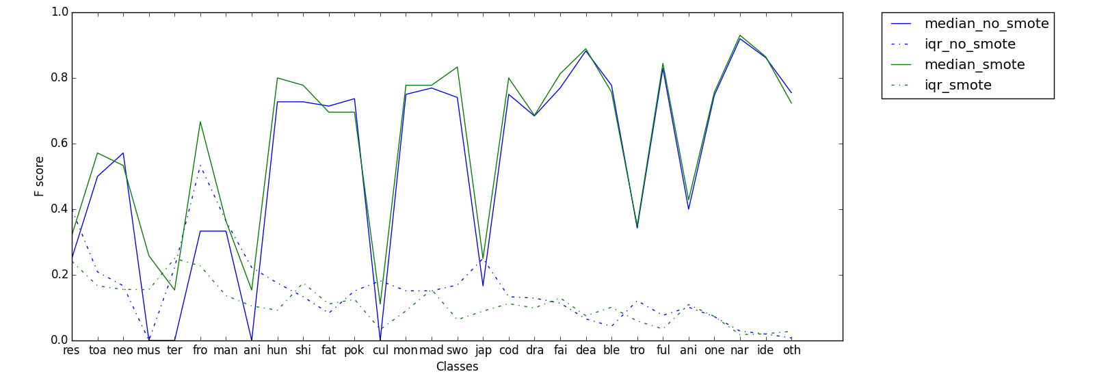
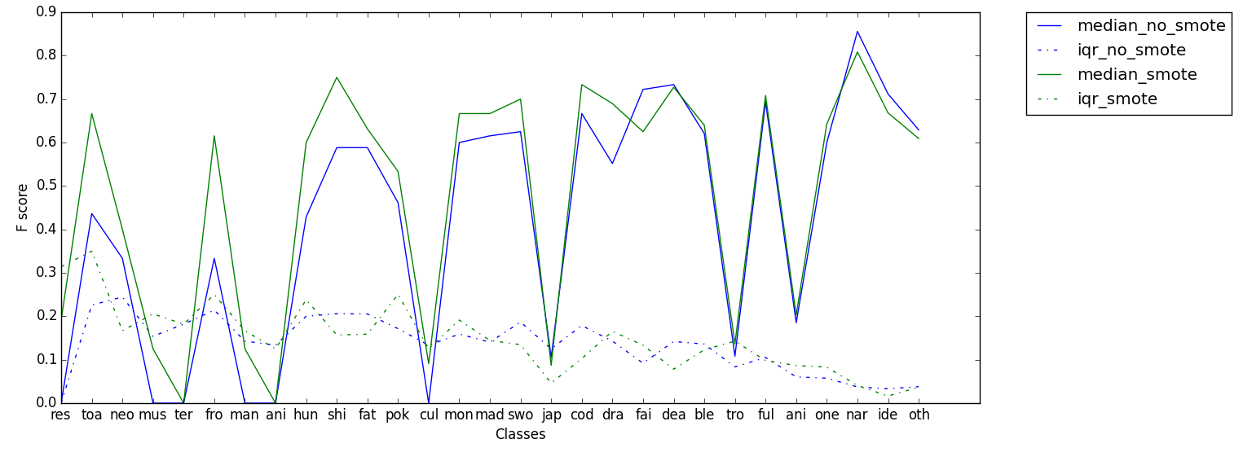
Automatically Generate Tags on StackExchange
Zhe Yu (zyu9)
Department of Computer Science, NC State University
Do NOT want to add tags for your posts?
Need suggestions on your tags?
Look HERE!
Raw Data: anime.txt
WORK FLOW
TRAINING
Task: generate tags by prediction
Problem: imbalance
Solution: SMOTE
Conclusion: linear SVM + SMOTE provides the best performance, 5000 features are enough, can provide reliable prediction of tags
Future works:
SVM with different kernels
transform multi-classification problem to binary ones and do SMOTE
test on other data sets
Tokenization: stemming + stop words removal
Train Classifiers: SVM, Naïve Bayes, Decision Tree
SMOTE
Training Set
Featurization: term frequency + L2 normalization + tf-idf selection
Evaluate Results:
Fscore_M, Fscore_mu
Split Data for Cross Validation
Test Set
PRE-PROCESSING
TESTING
Repeat
Naïve Bayes
SVM
Decision Tree

